Slide 1
Employee Performance Analysis Using Excel
STUDENT NAME: Yuvashree B
REGISTER NO: 312203011
NMID: B8134E50524113E84D74051739C2B68E
DEPARTMENT: Commerce[B.com]
COLLEGE: Asan Memorial College of Arts & Science

Slide 2


PROJECT TITLE
Employee Performance Analysis using Excel Techniques

Slide 3


AGENDA
Problem Statement
Project Overview
End Users
Our Solution and Proposition
Dataset Description
Modelling Approach
Results and Discussion
Conclusion
3/21/2024 Annual Review

Slide 4


PROBLEM STATEMENT
Employee Performance Evaluations can help you easily know about the good work and efforts of the top performers. You will be able to provide positive reinforcements for carrying out tasks properly. Positive reinforcements are crucial for boosting workplace morale and the good performance of the employees.

Slide 5


PROJECT OVERVIEW
Employee data analysis, also known as employee analytics or workforce analytics, is the process of collecting,analzying,and interpreting employee data to improve decision-making, productivity and the workplace environment

Slide 6
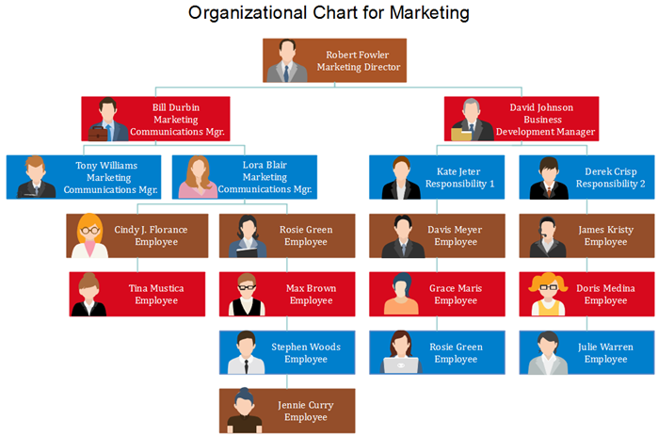
WHO ARE THE END USERS?

Slide 7


OUR SOLUTION AND ITS VALUE PROPOSITION
FILTERING – By removing missing
values.
HIGHLIGHTing BY COLOURS.
CONDITIONAL FORMATTING.
Pivot table
Graph – for data analysing
formula

Slide 8

Dataset Description
Employee dataset collect from IBM dashboard.
There are 26 features in the dataset.
Only 10 features we collect in the dataset.
The 1st data is employee id in numerical value.
The 2nd data is employee’s first name & and last name.
We collect the types of employees.
Calculating the level of performance.
Employee’s performance score.
Current employee’s rating in the analysis.

Slide 9
MODELLING
DATA COLLECTION:
1. Dataset download from edunet dashboard.
2. Employee performance analysis dataset using with excel.
FEATURES COLLECTING:
1. There are 26 features in the data.
2. Emp id, first name, last name, start date, exit date, title, supervisor, email , department ect.
3. In this 26 features I will collect only 10 features.
4. Emp id, first name, last name, business unit, employee status, employee type, employee class, gender code, employee performance, emp rating, performance level.
9

Slide 10
DATA CLEANING:
1. In the data cleaning we also use conditional formatting.
2. Identifying the missing values.
3. Using with conditional formatting and highlighting by colors.
4. Remove those blank values with using filter.
PERFORMANCE LEVEL CALCULATING:
1. Using formula in performance level calculating.
2. =ifs(Z8>=5,”VERY HIGH”,Z8>=4,”HIGH”,Z8>=3,”MED”,TRUE,”LOW”)
SUMMARISING (PIVOT TABLE):
1. Collect the data from the excel sheet.
2. summarize the value using pivot table.
3. A particular data is set to be in the row, column, filter and value.
4. And we use slicer to select the fields to use for filtering like
employee type, employee class ect…

Slide 11
CHARTS FOR PIVOT TABLE:
1. Click on the pivot table to activate the pivot table tools.
2. Click pivot chart in the tools group.
3. Choose the column chart and entre the trend value and chart heading.
RESULT:
1. In pivot table filtered the gender in male total = 287
2. In pivot table filtered the gender in female total = 212
3. Finally the pivot table gives a grand total = 499

Slide 12
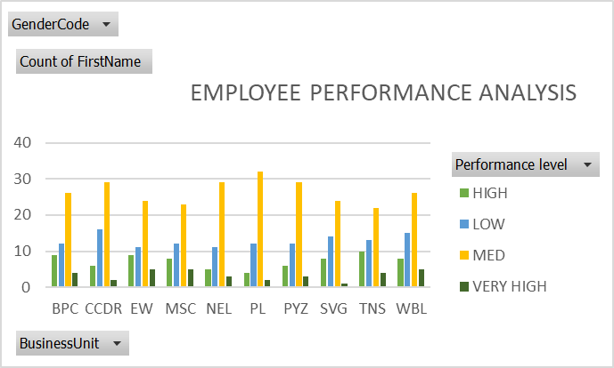
RESULTS
12

Slide 13
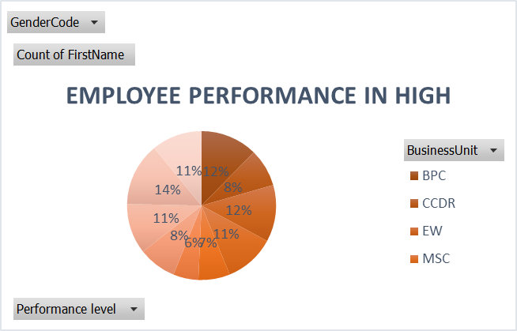

Slide 14

conclusion
Highlight the employee’s strengths, areas for improvement, and any patterns observed.
The medium level of employees are high.
So we can improve the very high and high level of workers.
We provide bonus, incentives etc for workers.

